Slide 1
Cold welding in THE VACUUM ENVIRONMENT
GARRETT KENNEDY

Slide 2
Cold welding
Explanation of Phenomenon
Mechanisms of Exposure
Galileo Incident 1991
Mitigation

Slide 3
What Is cold welding?
Bonding of clean metal surfaces without heat
Does not normally, or easily occur in atmosphere
Due primarily, to the “soup-like” structure of metals and the lack of available oxygen

Slide 4
COLD welding – explanation of phenomenon
Without oxidation, metals can fuse together when in contact
With air constantly oxidizing the surface of the metal, the two pieces will not fuse
In a vacuum, the metals will not have their surface oxidized and will fuse when in contact

Slide 5
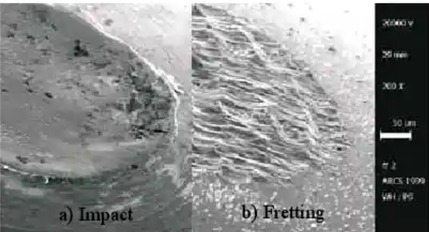
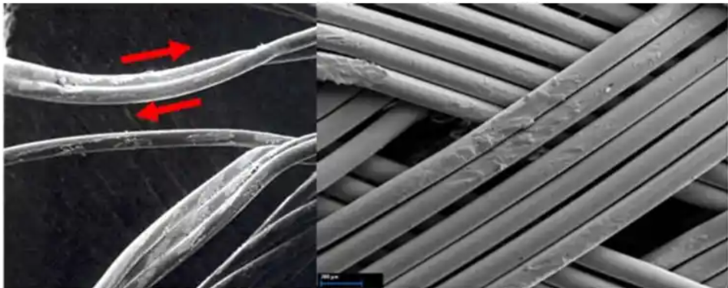
Cold welding – mechanisms of exposure
The surface of metals will generally be at least thinly oxidized when a spacecraft is constructed, but when the surface of those metals are damaged in vacuum, there is no available air to oxidize the newly exposed metal
Impact, fretting, galling, and bending are different mechanisms for exposing unoxidized metal
[1]
[2]

Slide 6
Cold welding – mechanisms of exposure
GALLING
BENDING
FRETTING
IMPACT

Slide 7
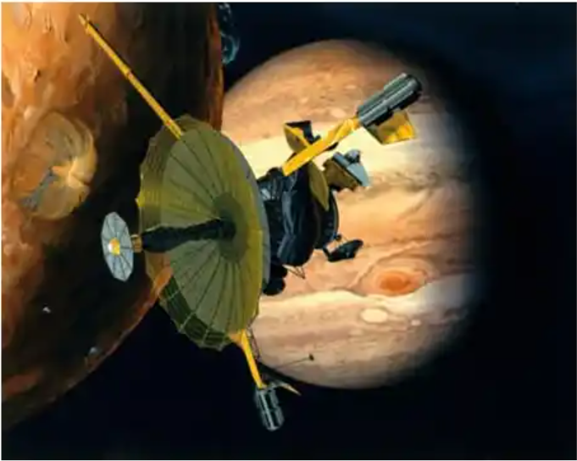
Galileo cold welding incident
1991 – High-gain antenna dish on a Galileo spacecraft failed to deploy
3 ribs of the folding high-gain antenna cold welded to the frame they were attached to as a result of fretting during the journey to target orbit
[2]

Slide 8
mitigation
Avoid metal on metal contact
When impossible, use coatings and assess risk
Use a Cold Welding database such as https://coldweld.aac-research.at/

Slide 9
Mitigation – Preventing metal on metal
Grease – effective for non-separable contacts but prone to outgassing [2]
Washers and barriers – non-metallic materials like ceramics and polymers are not known to cold weld [2]
Coatings – more is better, and methods of coating that integrate into the surface of the metal should be preferred [2]

Slide 10
references
[1] A. Merstallinger, M. Sales, and E. Semerad, “Assessment of Cold Welding Between Separable Contact Surfaces Due to Impact and Fretting Under Vacuum”, Austrian Institute of Technology, European Space Agency, Nov 2009
[2] Roland Holzbauer, Andreas Merstallinger, Lionel Gaillard, and Nathan Bamsey, “Cold Welding under Space and Launch Conditions”, 47th Aerospace Mechanisms Symposium, NASA Langley Research Center, May 15-17 2024

